Slide 1
Corporate Planning Process Time Plan VP Workshop 16.04.2026
16.04.26
GF-KS
COMPANY CONFIDENTIAL

Slide 2
definitions
Corporate Planning Process (CPP)
Describes the company-wide process for translating strategy into concrete goals, budgets, resource decisions and operational measures over the multi-year and annual period.
Business plan (BP)
Refers to the yearly updated document (ppt, booklet, pdf…) that summarizes the 5-year strategy and financial perspective (incl. various additional information e.g. competitor analysis, business fields etc.).
Targets
Targets are binding quantitative or qualitative target values (e.g. revenue, earnings, OI) that are derived from the strategy and serve as a framework for planning.
Wirtschaftsplan (WP) / Budget
The budget is the binding annual financial plan that specifically determines order income and revenue, costs, resources and investments for the coming financial year.
Workstream 1 & 2: Financial Planning Process
This refers to the planning process that generates the figures for the five-year business plan, as well as the budgeting process and the relationship between the two.
COMPANY CONFIDENTIAL

Slide 3
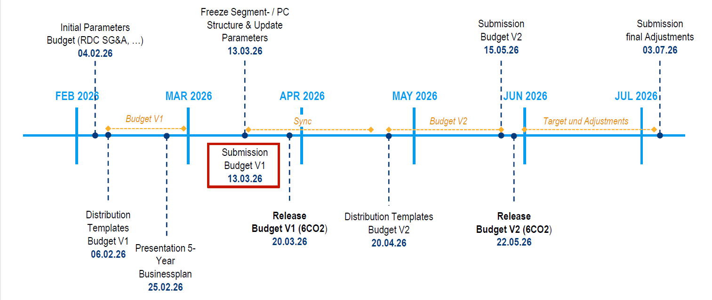
Budget Planning Milestones / Phases
Focus — Scope of the Analysis Phase
dsf
COMPANY CONFIDENTIAL

Slide 4
Distinguishing between 1-y and 5-y planning :
-shares all of our p. division starts in Februaary at the end of the 5-year plan : XXX presented it is then sent to the regions : there are no standard formats the inputs that are collected
Emails and excels that are the premises
Budget v1 : bottom up planning
Some of the presentation are shared in the company
Normally we have a growth of 1 or 10%:
When they submit the budget : some one takes the total and adjust and the second budget planning starts : it's about iteration
Second budget : target of alignment in july : see the real issues
BP V2 : sometimes bottom up : put all the stuff in SAP aligned
Regions : calculates : first clean the budget
What happens between BPv1 en BPv2 ? More insights from the top :
Is not just formatting for the output : first step li
At the end of the budget :
Try to intergrate AI within the steps : where the numbers come from ?
Copying the emails :

Slide 5
Template of excel : not the combined work : every one of the 200 people
Output tool : to integrate in SAP
Biggest issue : combine and solve
Planning : 13 plastic plan :
Google difficulties what are
Send our ideas and get comments

Slide 7
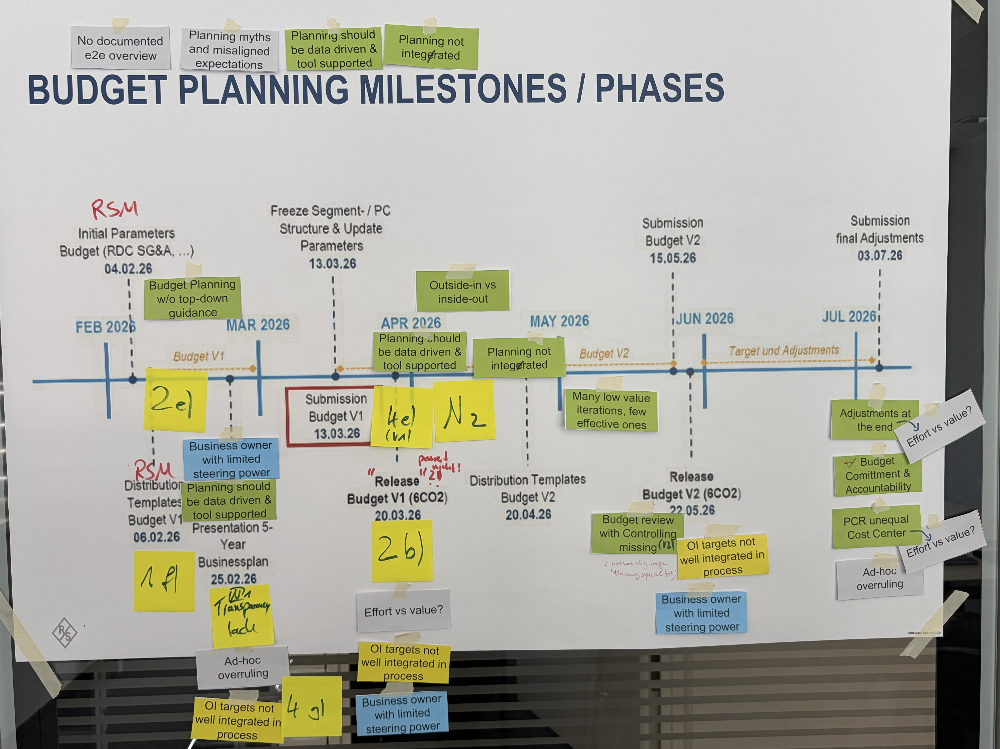
Budget Planning Milestones / Phases
COMPANY CONFIDENTIAL

Slide 8
Budget Planning Milestones / Phases - digital
Planning myths and misaligned expectations
No documented e2e overview
No documentation of BP assumptions decisions
Outside-in vs inside-out
Planning not integerated
Budget Planning w/o top-down guidance
Budget planning w/o knowledge of BP
Ambition not supported
Planning should be data driven & tool supported
Planning not integerated
Pre-alignment with controlling missing
Budget review with Controlling missing (V1)
Inter company alignment lack
Many low value iterations, few effective ones
Business owner with limited steering power
Adjustments at the end
Budget Comittment & Accountability
Effort vs value?
Planning should be data driven & tool supported
Effort vs value?
Budget Comittment & Accountability
Regional input for topline planning missing
OI targets not well integrated in process
PCR unequal Cost Center
Transparency -> unclear who needs to know what when
Budget review with Controlling missing (V2)
Effort vs value?
Business owner with limited steering power
Ad-hoc overruling
Ad-hoc overruling
OI targets not well integrated in process
OI targets not well integrated in process
Business owner with limited steering power
Premises for BP w/o alignment
COMPANY CONFIDENTIAL

Slide 9
Draft of High-LEveL Target Process with focus on Budget planning
Brainstorming / Drafting Target process
BP-Presentation March
June
1
2
3
4
5
6
7
Outcome
Business Plan
(Top-down)
Premises
Setting
Finetuning / Cascading
Bottom-Up Planning
(KST + PCR)
Alignment & Challenge (Plausibility)
Decision &
Sign-off (Alignment)
Communication & Cascade
Final Budget
Financial Plan for FY steering and (Performance measurement)
Basis for targets
OI | functional costs | P&L
(all rel. dimensions)
Deadline: 30.06.2026
Info
Defines the strategic direction with a 5-year perspective
Translate strat. direction into premises, providing guardrails for the op. planning
Regional cascading to sales offices / countries
Develop detailed budget aligned with top-down targets and assumptions
Compare top-down and bottom-up, challenge gaps and ensure consistency
Consolidate inputs, make trade-offs and take final decisions
Communicate the plan and cascade targets into the organization
Input
Corp. strategy
Consolidated market intelligence of the HQ BOs & sales org. incl. (alignment meeting)
Alignment Controlling
Strategic priorities & targets
Planning assumptions & guardrails incl. OI, GM and SG&A
Historical performance (controlling)
Planning premises per region and relevant business dimension | targets
Budget expectation per country
Controlling
Operational insights
Top-down targets
Bottom-up plans
Consolidated plan (Controlling)
Open issues / trade-offs
Approved plan (GF)
Final targets
Output
Strategic priorities and targets
Planning assumptions & guardrails incl. OI, GM and SG&A
Planning premises per region and relevant business dimension | targets
Budget expectation per country
Detailed budget per sales offices (country | region) in relevant dimensions
Key assumptions and reasoning | Initiatives
Identified gaps
Aligned and adjusted plans including measures
Final approved plan
Clear decisions on priorities
Communicated targets across organization
Alignment of budgets and execution plans
Owner
GF
Business Owner
Regional Heads
Regional Heads
(Controlling, Business Owner? Corporate?)
GF
Business Owner (div heads) for UB, Regional heads for Sales
Step 1→2: Extract BP assumptions → auto-generate premises
Step 4→5: Instantly flag every gap between top-down and bottom-up
Step 5→6: Trace each gap back to its original BP assumption
Where AI intervenes
COMPANY CONFIDENTIAL
Step 2→4: Cascade premises to regions automatically

